Slide 1
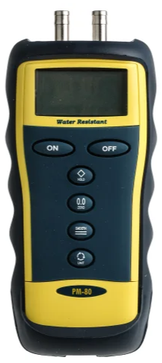
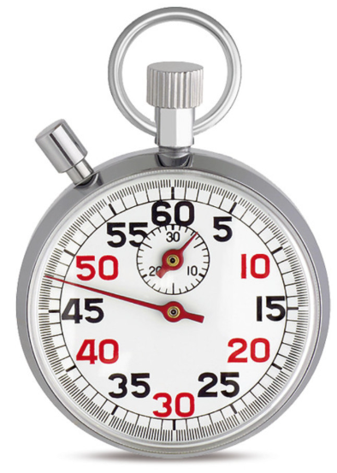
How accurate are our measurements in this experiment?
Pressure
Volume
Elapsed time
How accurate is this device?
Can we achieve having no bubbles in the connecting tubes?
Do we perfectly know how much volume we accumulate?
Are we starting and stopping the time at really correct times?
How well do experimental and theoretical friction factors (λ) align under these uncertain factors?
We created a windows app for investigating this.

Slide 2
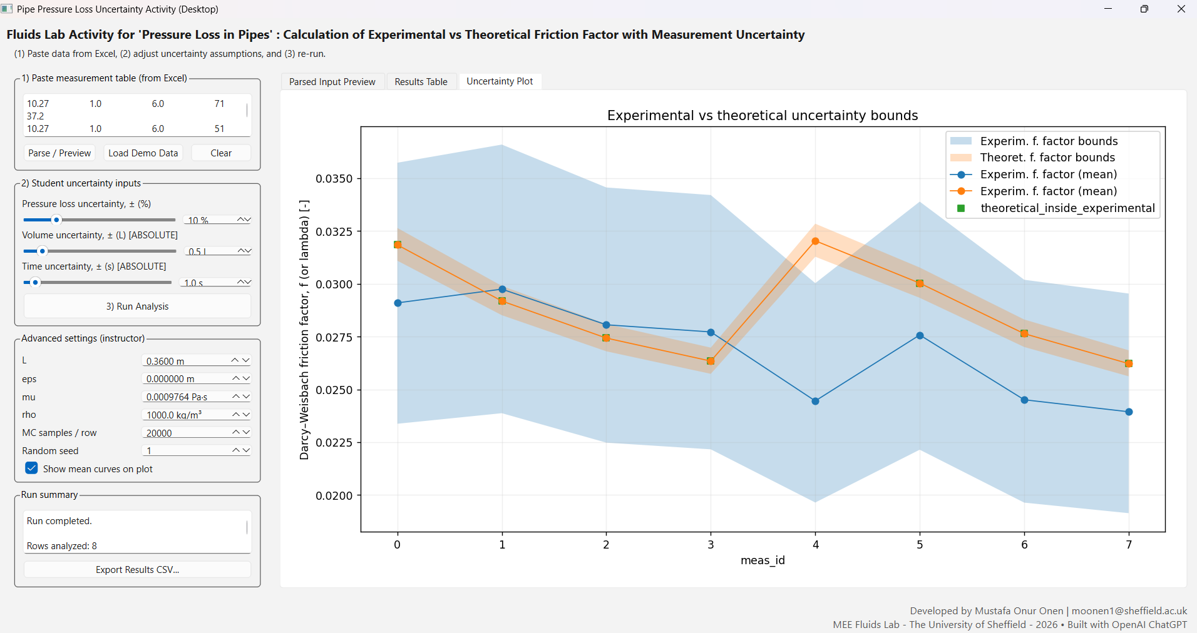
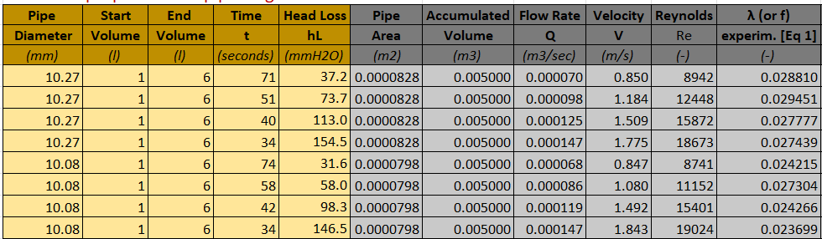
Copy and paste your measurement data from excel into the text box. (Input 1)
Click “Run Analysis”
Display “Uncertainty Plot”
Adjust 3 uncertain factors (Input 2) and click “Run Analysis” to update the figure until you get a sufficient coverage.

